Slide 1
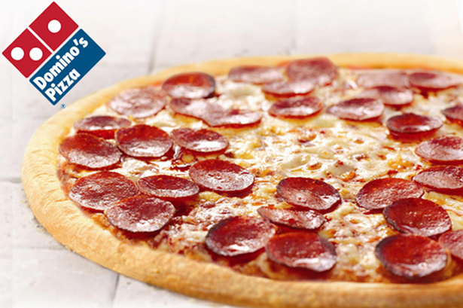
2016 SITUATION ANALYSIS

Slide 2
Domino’s Pizza, Inc.
Domino’s is the second largest pizza restaurant chain in the world
  more than 85 international markets
  more than 13,800 locations
  more than 290,000 employees work in the Domino’s Pizza system
Business Segment
  4,979 domestic franchise stores
  8,440 international franchise stores
  18 regional dough manufacturing and food supply chain centers
Domino’s is the market share leader in the delivery segment
Domino’s is amongst the top three chains in share in the carryout segment
Notes:
Domino’s Pizza, Inc. 2016 Annual report. Retrieved from: http://phx.corporate-ir.net/phoenix.zhtml?c=135383&p=irol-reportsannual

Slide 3
Our Mission
To be the leader in delivering off-premise pizza convenience to consumers around the world as a team
  Being fanatical about product quality and service consistency
  Providing product variety to meet all customer needs
  Placing team member and customer safety and security above all other concerns
  Creating an environment in which all team members feel valued
  Building and maintaining relationships that reward franchisees and other partners for their contributions
Notes:
Domino‘s Pizza, Inc. - Company Profile, Information, Business Description, History, Background Information on Domino’s Pizza, Inc.
(n.d.). Retrieved from : http://www.referenceforbusiness.com/history2/60/Domino-s-Pizza-Inc.html#ixzz4wtSrDJtD

Slide 4
Our Vision
Exceptional people on a mission to be the best pizza delivery company in the world
  Put the people first
  Build the brand stores
  Achieve flawless execution
  Maintain high standards
Notes:
Put people first
Team Members are the backbone of the company. To become the best pizza delivery company in the world, we need to treat team Member accordingly: rewarding dedication and hard work with opportunities for personal growth and career progression.
Build the brand stores
Domino's must continue to grow by looking for opportunities to strengthen its existing markets and building stores in the new markets. We must also continue to strength our brand through providing exceptional quality and service.
Achieve flawless execution
To exceed our customer's expectations, Dominos need to strive to execute store operations flawlessly. Every order must go out the door quickly, correctly and at the highest quality possible, creating and maintaining loyal customer.
Maintain high standards
We have set very high quality standards. We must make sure those standards are being met at every step of the process.
References:
Essays, UK. (November 2013). Vision And Strategy To Achieve Vision Domino Pizza. Retrieved from https://www.ukessays.com/essays/management/vision-and-strategy-to-achieve-vision-domino-pizza.php?cref=1

Slide 5
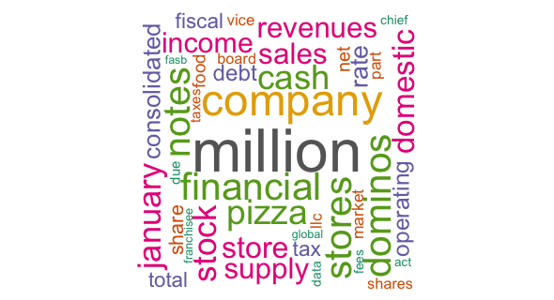
Word Cloud based on the annual report
As we mentioned in the previous pages, the key words can be found easily in the word cloud such as “chain”, “supply”, etc.
Notes:
This word cloud is a summary of Domino’s Pizza, Inc. 2016 Annual report. We could find that the key words are ”international”, “financial”, “supply”, “chain”, “domestic”, etc. This means the annual report is more focus on the financial, business segment and organization system. (Just like we mentioned in the previous pages)

Slide 6
SWOT analysis of Domino’s Pizza
Strengths
Opportunities
Brand Recall
Fantastic channel network
Quick service & deep menu
Low cost alternative
Healthier alternatives
Efficient supply chain
Market Expansion
Penetration
Health conscious eatables
Restaurants
Notes:
Strengths in the SWOT analysis of Dominos
Brand Recall: High brand recall due to its regular advertising with taglines such as ‘30 minutes nahi to free’. Such aggressive marketing has created awareness & a promise for the brand in the market.
Fantastic channel network: With its 9000 franchise & company owned outlets Dominos has extensive network spread over more than 60 countries.
Quick service & deep menu: Quicker than expected service delights the consumers and helps the company to differentiate itself from others. In India Domino’s is trying to attract the middle class and lower middle class people who are interested to spend their money on pizza but in low price. Those people are eager to go for an outing in any festival and want cheap and best family restaurant. Domino’s would be most preferable.
Low cost alternative: They do not need high class Ambiance or amusement in the shop so the establishment cost is low for the dealers and the price of pizza is very reasonable for the customers.
Healthier alternatives: To combat health awareness among consumers, Dominos is trying to change their dough by having healthier fats, which is done by incorporating more whole wheat into their crusts. The pizza toppings are also becoming healthier, and some pizzerias are introducing salads into their menus.
Efficient supply chain: Due to its efficient supply chain Dominos has made it possible for quicker service so that customers don’t have to wait for long. The preference of Dominos is because the customer can have home delivery within 30 minutes. Making a small breakfast at home itself takes 15 minutes.
Opportunities in the SWOT analysis of Dominos
Market Expansion: Expanding to the developing markets will be beneficial as far as Pizza industry is concerned, as developed markets are maturing. Targeting the developing economies should be the future strategy of the company.
Penetration: Strengthening its outlet network by further penetrating the current market will help Dominos to increase its revenues.
Health conscious eatables: Introducing health conscious menu with new flavor additives which is low in fat will result in increasing it revenues in future.
Restaurants: By introducing exclusive Dominos restaurants in cream areas will help the brand with more brand recognition and will also help in getting the customers who like to eat outside in plush restaurants.
Reference: Hitesh Bhasin (2016). Dominos SWOT analysis – SWOT analysis of Dominos. Retrieved from: https://www.marketing91.com/swot-analysis-of-dominos/

Slide 7
SWOT analysis of Domino’s Pizza
Weaknesses
Threats
Operations
Decreasing sales in mature
Low staff retention
Lesser number of eateries
Direct and Indirect Competition
Changing Consumer Eating habits
Cost
Notes:
Weaknesses in the SWOT analysis of Dominos
Operations: Large number of franchised outlets results in difficulty in handling operations. Quality control too becomes challenging. Due to this, some of the Dominos outlets got closed affecting the image of the brand.
Decreasing sales in mature mature: Due to rise in health conscious population there is decrease in revenue affecting the business as a whole.
Low staff retention: High attrition due to the absence of proper training & development is a major challenge for Dominos. Plus the manpower employed is also unskilled so they quickly change jobs when they cannot adjust to the hectic environment.
Lesser number of eateries: Dominos has more delivery outlets then eating joints which is a problem especially in places like malls and other locations where clearly customers want a sitting place.
Threats in the SWOT analysis of Dominos
Direct and Indirect Competition: Intensive competition from the local & national players like “Pizza hut”, US pizza and more. In fact, Indirect competition is more from the likes of McDonalds and KFC wherein customers prefer burgers over pizza.
Changing Consumer Eating habits: With government & NGO’s concentrating more on health awareness, people are becoming more aware of what to consume & what to avoid which is affecting the business of Dominos.
Cost: As the cost of vegetables and raw materials rises, the cost of maintaining the pizza chain also goes up. Plus, competition affects the bottom line of the company. Thus managing the cash flow becomes difficult.
Reference: Hitesh Bhasin (2016). Dominos SWOT analysis – SWOT analysis of Dominos. Retrieved from: https://www.marketing91.com/swot-analysis-of-dominos/

Slide 8
DOMESTIC MARKET COMPARISON
They have more stores than us
Their expansion is quicker than us
However, the income disparities between us kept same
Notes:
This is the comparison between Domino’s domestic stores and Papa John’s domestic stores.

Slide 9
INTERNATIONAL MARKET COMPARISON
Our international stores’ number are almost 8 times more than Papa John’s
Domino’s international stores have more profit margin than Papa John’s
Notes:
This is the comparison between Domino’s international stores and Papa John’s international stores.

Slide 10
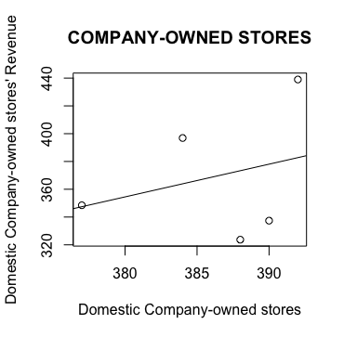
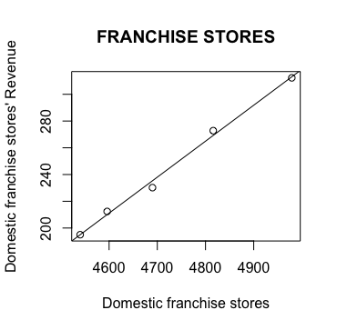
Regression analysis(domestic market)
The number of our domestic stores are increasing
Company-owned stores play a more important role in domestic revenues
More franchise stores means more revenue.
Y = 2.355X - 540.445, where Y = company-owned stores revenue, X = total company-owned stores
Z = 0.269P - 1026.328, where Y = franchise stores revenue, P = total domestic franchise stores
Notes:
Based on the regression graph, Franchise stores does less affect on total domestic revenues
More number of both kinds of stores means more revenue.
However, franchise stores are more affect.
Y=2.355*X – 540.445 (Company-owned stores)
Y=0.269*X – 1026.328 (Franchise stores)

Slide 11
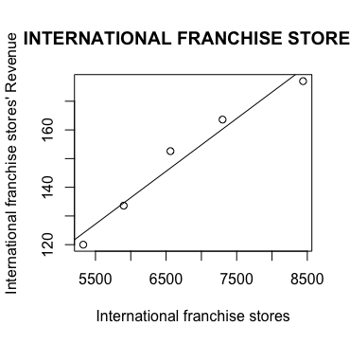
Regression analysis (International market)
More stores means more sales
More sales bring more revenues
The number of our international franchise stores is growing steady
Y($m) = 0.01839X + 26.00919, where Y = international franchise stores’ revenue,
X = international franchise stores
Notes:
The residual standard error is 5.183 on 3 degrees of freedom. The multiple R-squared is 0.9614
These data means this model could predict the revenue directly. (but still not able to predict perfectly)
More international franchise stores bring more revenues
Y=0.01839 *X+26.00919

Slide 12
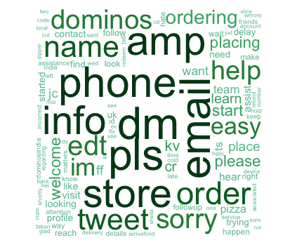
Twitter word cloud
As we can see there, there are many words like “pls”, “help” and “sorry”
This means we still need to improve our services

Slide 13
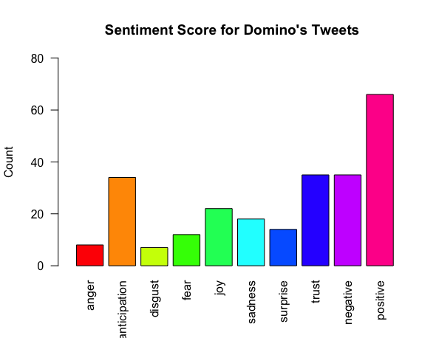
Sentiment analysis based on Tweets
We can see there are more than half tweets positive. However, we still need to improve our services.

Slide 14
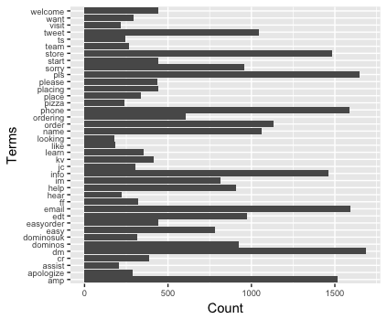
Twitter analysis(Word frequency)
Services! Services! Services!
Most of our Twitter replies are solving complains.
None of tweets show about our food quality. (all about services)

Slide 15
Conclusion
We should use our brand influences to expand market. (Both Domestic and International)
  For domestic market, we should have more franchise stores to get more revenues
We should keep our brand competitive in international market
We should put more effort on services

Slide 16
Reference
Domino’s Pizza, Inc. 2016 Annual report. Retrieved from: http://phx.corporate-ir.net/phoenix.zhtml?c=135383&p=irol-reportsannual
Domino‘s Pizza, Inc. - Company Profile, Information, Business Description, History, Background Information on Domino’s Pizza, Inc.
(n.d.). Retrieved from : http://www.referenceforbusiness.com/history2/60/Domino-s-Pizza-Inc.html#ixzz4wtSrDJtD
Essays, UK. (November 2013). Vision And Strategy To Achieve Vision Domino Pizza. Retrieved from https://www.ukessays.com/essays/management/vision-and-strategy-to-achieve-vision-domino-pizza.php?cref=1
Hitesh Bhasin (2016). Dominos SWOT analysis – SWOT analysis of Dominos. Retrieved from: https://www.marketing91.com/swot-analysis-of-dominos/

